Slide 1
Virtual Memory
Demand paging
Copy-on-Write
Page-replacement
Allocation of frames
Thrashing.

Slide 2
Background
Code needs to be in memory to execute, but entire program rarely used
Error code, unusual routines, large data structures; are all seldom used
Ex: declared array of size 100 cells but only 10 cells are used
Entire program code not needed (in main memory) at the same time
Consider ability to execute partially-loaded program
Less I/O needed to load or swap programs into/from memory
Thus, each user program would run faster

Slide 3
Cont..
Virtual memory – separation of user logical memory from physical memory
As perceived by users; that programs exist in contiguous memory
Abstracts physical memory: need not worry about memory requirements
Only part of the program needs to be in memory for execution
Logical address space can therefore be much larger than physical address space
Programmers can work as if memory is an unlimited resource

Slide 4
Cont..
Allows address spaces to be shared by several processes
Allows for more efficient process creation
More programs running concurrently; increased multi-programming and/or time-sharing
Less I/O needed to load or swap processes; hence, faster program execution

Slide 5
Cont..
Virtual address space – logical view of how process is stored in memory
Usually start at address 0, contiguous addresses until end of space
Meanwhile, physical memory organized in page frames
MMU must map logical to physical
Virtual memory can be implemented via:
Demand paging
Demand segmentation

Slide 6
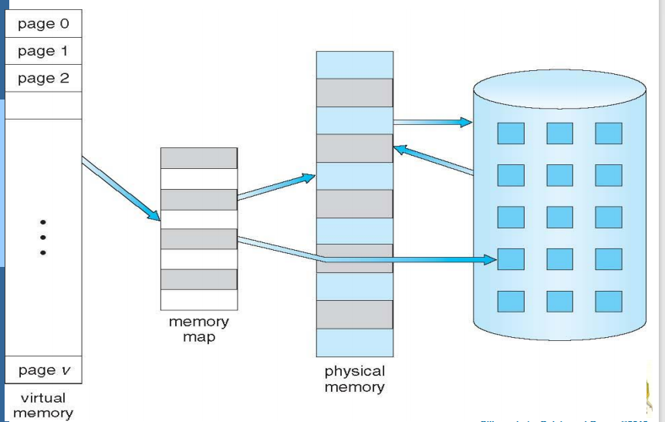
Virtual Memory That is Larger Than Physical Memory
Physical memory may be organized in page frames and that the physical page frames assigned to a process may not be contiguous.
It is up to the memory management unit (MMU) to map logical pages to physical page frames in memory

Slide 7
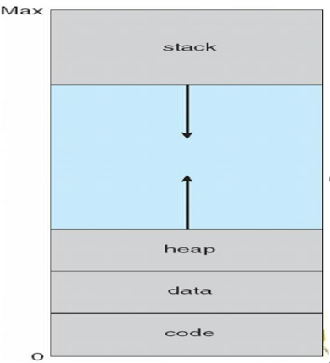
Virtual-Address Space of a Process
Usually design logical address space for the stack to start at Max logical address and grow “down” while heap grows “up”
Maximizes address space use
Unused address space between the two is hole
No physical memory needed until heap or stack grows to a given new page
Enables sparse address spaces with holes left for growth, dynamically linked libraries, etc.
Pages can be shared during fork(), speeding process creation

Slide 8
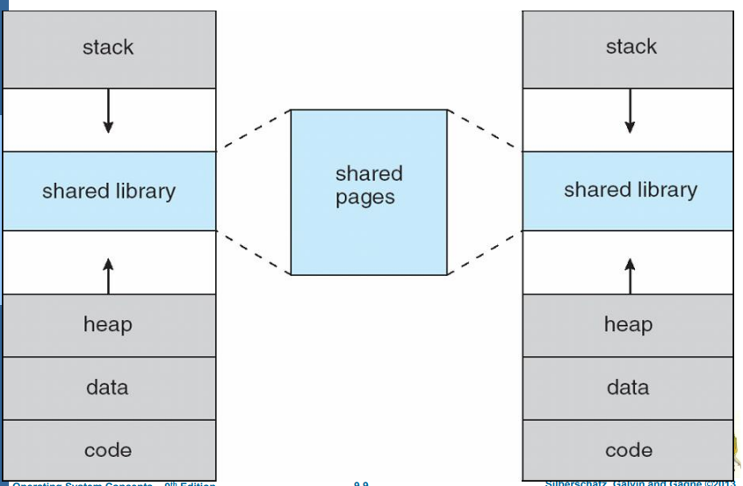
Shared Library Using Virtual Memory

Slide 9

Demand Paging
Could bring entire process into memory at load time
Or bring a page into memory only when it is needed
Less I/O needed, no unnecessary I/O
Less memory needed
Faster response
More users

Slide 10
Demand Paging
Similar to paging system with swapping (diagram on right)
invalid reference ⇒ abort
Not-in-memory ⇒ bring to memory
Lazy swapper – never swaps a page into memory unless page will be needed
Swapper that deals with pages is a pager

Slide 11
Basic Concepts
When swapping in a process, the pager guesses which pages will be used before swapping it out again
The pager brings in only those needed pages into memory
Thus, decreases swap time and amount of needed physical memory
Need new MMU hardware support to implement demand paging
To distinguish between in-memory pages and on-disk pages
Uses the valid—invalid scheme

Slide 12
Basic Concepts
If pages needed are already memory resident
Execution proceeds normally
If page needed and is not memory resident;
Need to find the needed page from the disk and load it into memory
Without changing program behavior
Without programmer needing to change code

Slide 13
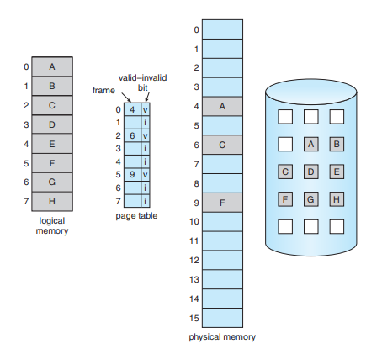
Page table when some pages are not in main memory

Slide 14
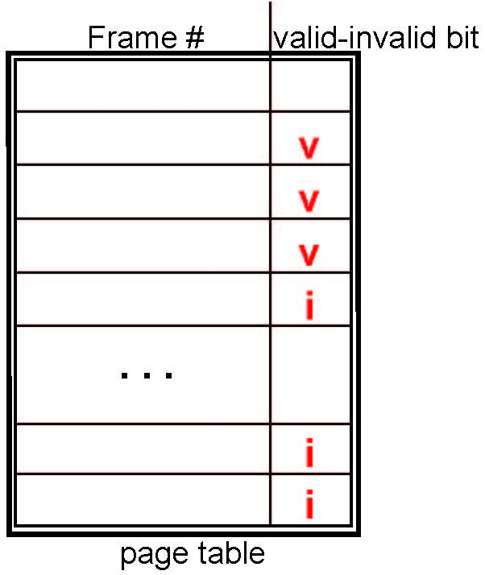
Valid-Invalid Bit
A valid–invalid bit is associated with each page-table entry;
With each page table entry a valid–invalid bit is associated (v ⇒ in-memory, i ⇒ not-in-memory)
Initially valid–invalid bit is set to i on all entries
Example of a page table snapshot:
During MMU address translation, if valid–invalid bit in the page table entry is i ⇒ page fault

Slide 15
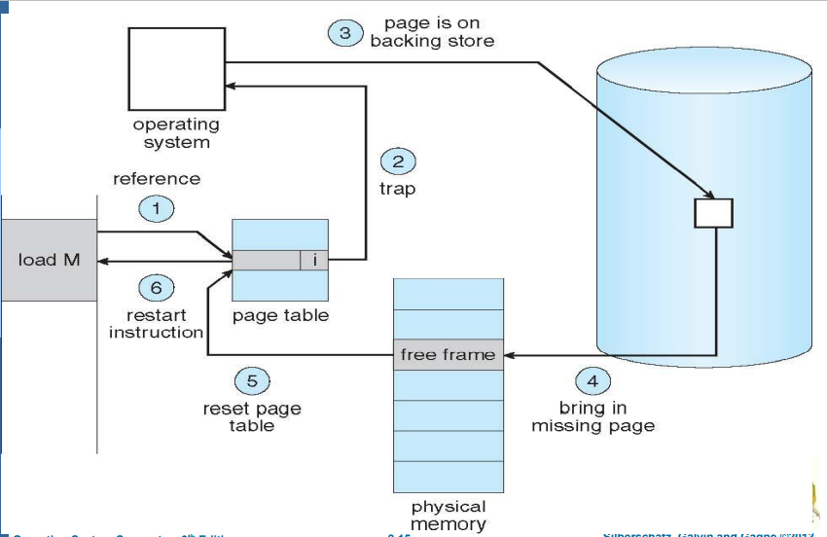
Steps in Handling a Page Fault

Slide 16
Aspects of Demand Paging
Extreme case – start process with no pages in memory
OS sets instruction pointer to first instruction of process; logical address = (p, d)
Since page p is non-memory-resident then a page fault is issued
Page p is loaded and… same for all other process pages on first reference
This scheme is pure demand paging: load a page only when it is needed

Slide 17
Cont..
A given instruction may refer to multiple distinct pages; thus, multiple page faults
Consider fetching the instruction “ADD A, B” and fetching the values of data A and B from memory and then storing the result back to memory
Addresses of “ADD A, B”, “A”, and “B” may all be in three different pages
Multiple page fault per instruction results in unacceptable performance
Very unlikely, fortunately, due to locality of reference;

Slide 18
Cont..
Hardware support needed for demand paging; same as hardware for paging and swapping
Page table with valid / invalid bit, or special protection bits
Secondary memory: swap device with swap space; for not in-memory pages
Instruction restart; ability to restart any instruction after a page fault

Slide 19
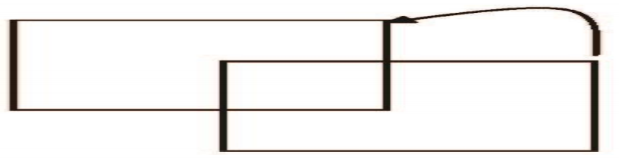
Instruction Restart
Consider an instruction that could access several different locations
block move
auto increment/decrement location
Restart the whole operation?

Slide 20
Copy-on-Write
Copy-on-Write (COW) allows both parent and child processes to initially share the same pages in memory
If either process modifies a shared page, only then is the page copied
COW allows more efficient process creation as only modified pages are copied
In general, free pages are allocated from a pool of zero-fill-on-demand pages
Pool should always have free frames for fast demand page execution
Don’t want to have to free a frame as well as other processing on page fault
Why zero-out a page before allocating it?

Slide 21
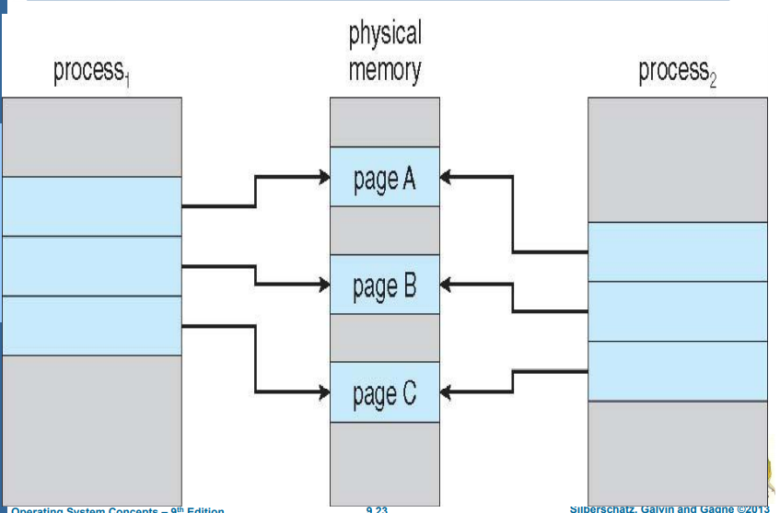
Before Process 1 Modifies Page C

Slide 22
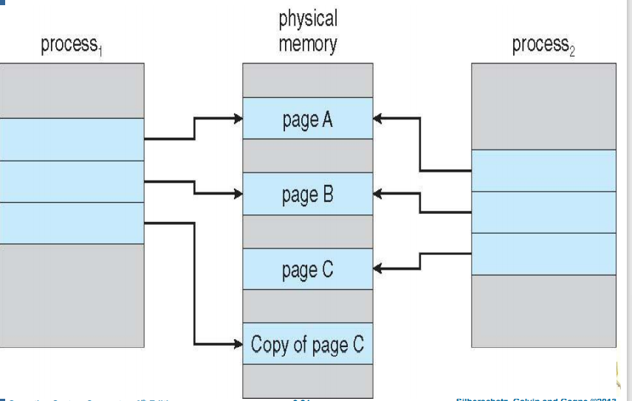
After Process 1 Modifies Page C

Slide 23
What Happens if There is no Free Frame?
Many pages need to be loaded but not enough free frames available from them
Solution: Page replacement; when paging in pages of a process but no free frames
Terminate the process?
Swap out some process?
Find currently un-used frame to free it;
Replacing the un-used memory page with the new page
Performance – want an algorithm which will result in minimum number of page faults

Slide 24
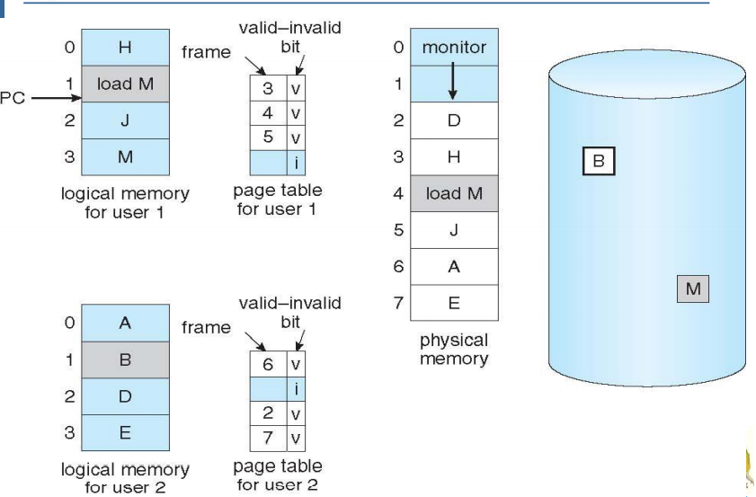
Need For Page Replacement

Slide 25
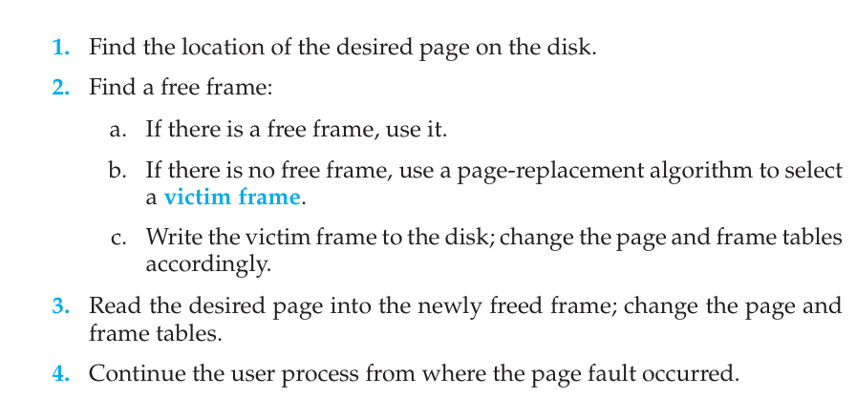

Slide 26
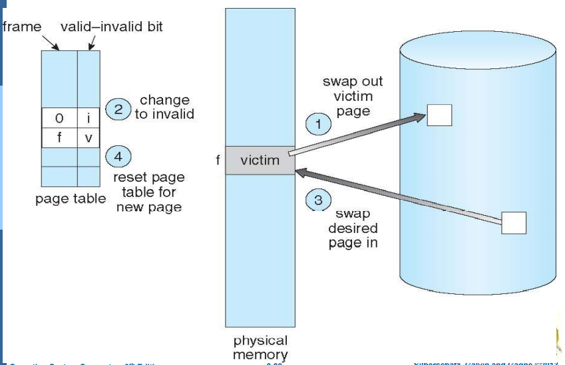
Page Replacement

Slide 27
Page and Frame Replacement Algorithms
Frame-allocation algorithm determines
How many frames to give each process
Which frames to replace
Page-replacement algorithm
Want lowest page-fault rate on both first access and re-access
In all our examples, the reference string of referenced page numbers is
7,0,1,2,0,3,0,4,2,3,0,3,0,3,2,1,2,0,1,7,0,1

Slide 28
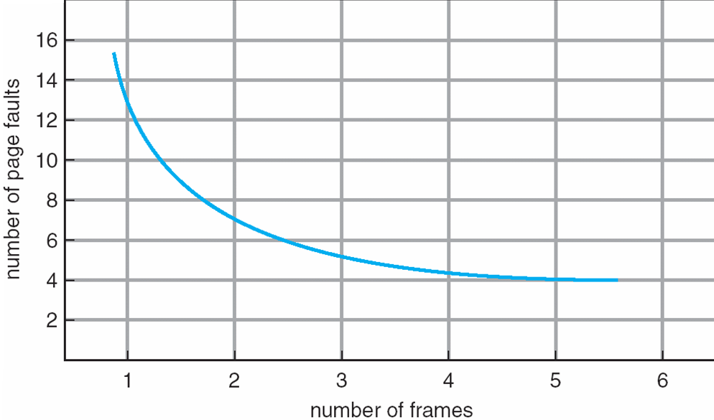
Graph of Page Faults Versus the Number of Frames

Slide 29
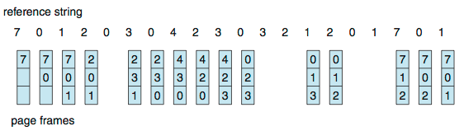
First-In-First-Out (FIFO) Algorithm
Reference string: 7,0,1,2,0,3,0,4,2,3,0,3,0,3,2,1,2,0,1,7,0,1
3 frames (3 pages can be in memory at a time per process)
How to track ages of pages?
Just use a FIFO queue

Slide 30
Belady’s Anomaly
Consider the string 1,2,3,4,1,2,5,1,2,3,4,5
Adding more frames can cause more page faults!
Graph illustrating Belady’s Anomaly

Slide 31
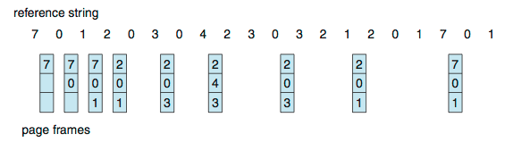
Optimal Algorithm
Replace page that will not be used for longest period of time
9 is optimal for the example
How do you know this?
Can’t read the future
Used for measuring how well your algorithm performs
Optimal is an example of stack algorithms that don’t suffer from Belady’s Anomaly

Slide 32
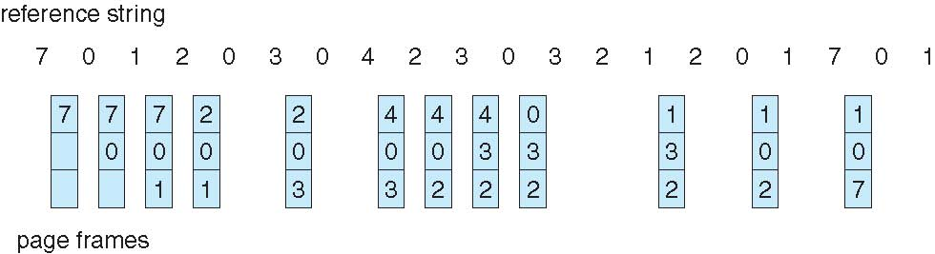
Least Recently Used (LRU) Algorithm
Use past knowledge rather than future
Replace page that has not been used in the most amount of time
Associate time of last use with each page
12 faults – better than FIFO but worse than OPT
Generally good algorithm and frequently used
LRU is another example of stack algorithms; thus it does not suffer from Belady’s Anomaly

Slide 33
LRU Algorithm Implementation
Time-counter implementation
Every page entry has a time-counter variable; every time a page is referenced through this entry, copy the value of the clock into the time-counter
When a page needs to be changed, look at the time-counters to find smallest value
Search through a table is needed
Stack implementation
Keep a stack of page numbers in a double link form:
Page referenced:
Move it to the top
But each update more expensive
No search for replacement

Slide 34
Stack Implementation
Use of a stack to record most recent page references

Slide 35
LRU Approximation Algorithms
Needs special hardware
Reference bit
With each page associate a bit, initially = 0
When page is referenced bit set to 1
Replace any with reference bit = 0 (if one exists)
We do not know the order, however

Slide 36
LRU Approximation Algorithms (cont.)
Second-chance algorithm
Generally FIFO, plus hardware-provided reference bit
Clock replacement
If page to be replaced has
Reference bit = 0 -> replace it
Reference bit = 1 then:
Set reference bit 0, leave page in memory
Replace next page, subject to same rules

Slide 37
Second-chance Algorithm

Slide 38
Enhanced Second-Chance Algorithm
Improve algorithm by using reference bit and modify bit (if available) in concert
Take ordered pair (reference, modify):
(0, 0) neither recently used not modified – best page to replace
(0, 1) not recently used but modified – not quite as good, must write out before replacement
(1, 0) recently used but clean – probably will be used again soon
(1, 1) recently used and modified – probably will be used again soon and need to write out before replacement
When page replacement called for, use the clock scheme but use the four classes replace page in lowest non-empty class
Might need to search circular queue several times

Slide 39
Counting Algorithms
Keep a counter of the number of references that have been made to each page
Not common
Lease Frequently Used (LFU) Algorithm:
Replaces page with smallest count
Most Frequently Used (MFU) Algorithm:
Based on the argument that the page with the smallest count was probably just brought in and has yet to be used

Slide 40
Page-Buffering Algorithms
Keep a pool of free frames, always
Then frame available when needed, not found at fault time
Read page into free frame and select victim to evict and add to free pool
When convenient, evict victim
Possibly, keep list of modified pages
When backing store otherwise idle, write pages there and set to non-dirty
Possibly, keep free frame contents intact and note what is in them
If referenced again before reused, no need to load contents again from disk

Slide 41
Applications and Page Replacement
All of these algorithms have OS guessing about future page access
Some applications have better knowledge – i.e., databases
Memory intensive applications can cause double buffering
OS keeps copy of page in memory as I/O buffer
Application keeps page in memory for its own work
Operating system can provide direct access to the disk, getting out of the way of the applications
Raw disk mode

Slide 42
Allocation of Frames
Each process needs minimum number of frames
Example: IBM 370 – 6 pages to handle SS MOVE instruction:
Instruction is 6 bytes, might span 2 pages
2 pages to handle from
2 pages to handle to
Maximum of course is total frames in the system
Two major allocation schemes
Fixed allocation
Priority allocation

Slide 43
Fixed Allocation
Equal allocation – For example, if there are 100 frames (after allocating frames for the OS) and 5 processes, give each process 20 frames
Keep some as free frame buffer pool
Proportional allocation – Allocate according to the size of process
Dynamic as degree of multiprogramming, process sizes change

Slide 44
Priority Allocation
Use a proportional allocation scheme using priorities rather than size
If high-priority process Pi generates a page fault,
select for replacement one of its frames
select for replacement a frame from a process with lower priority number

Slide 45
Global vs. Local Allocation
Global replacement – process selects a replacement frame from the set of all frames; one process can take a frame from another
Local replacement – each process selects from only its own set of allocated frames

Slide 46
Non-Uniform Memory Access
So far we have assume that all main memory is accessed equally
Many systems are NUMA – speed of access to memory varies
Consider system boards containing CPUs and memory, interconnected over a system bus or a high-speed network
Optimal performance comes from allocating memory frames “as close as possible to” the CPU on which the process or thread is running or scheduled
Thread issues solved by Solaris by creating lgroups; that is, latency groups
If not possible, then pick a nearby lgroup

Slide 47
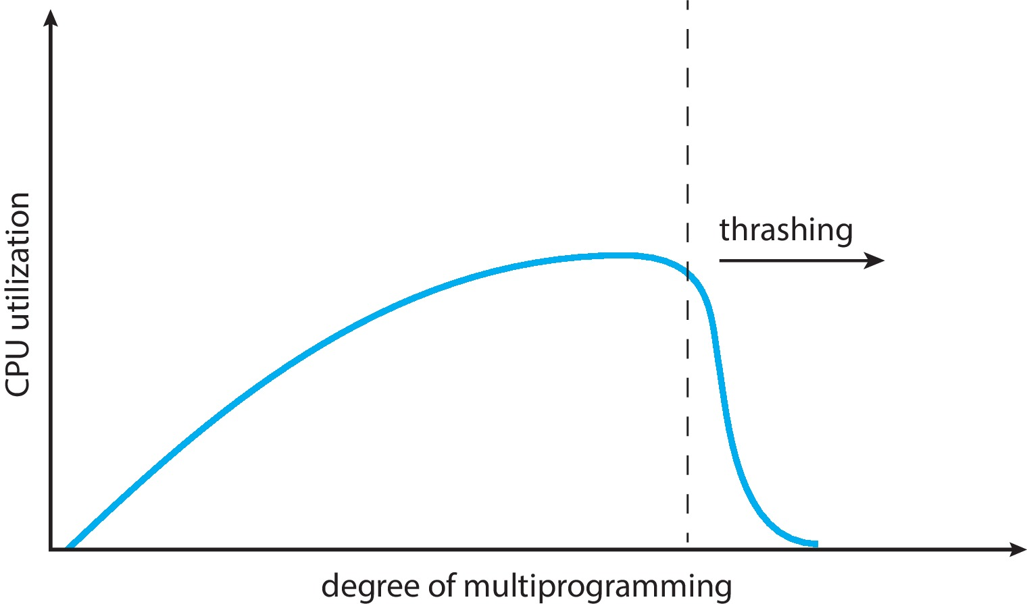
Thrashing
If a process does not have “enough” pages, the page-fault rate is very high
Page fault to get page
Replace existing frame
But quickly need the replaced frame back
This leads to:
Low CPU utilization
Operating system thinking that it needs to increase the degree of multiprogramming
Another process added to the system
Thrashing. A process is busy swapping pages in and out

Slide 48
Cont..
Locality model
Process migrates from one locality to another
Localities may overlap
Why does thrashing occur? Σ size of locality > total memory size
To avoid trashing:
Calculate the Σ size of locality
Policy:
if Σ size of locality > total memory size→ suspend or swap out one of the processes
Issue: how to calculate “Σ size of locality”

Slide 49
Locality In A Memory-Reference Pattern

Slide 50
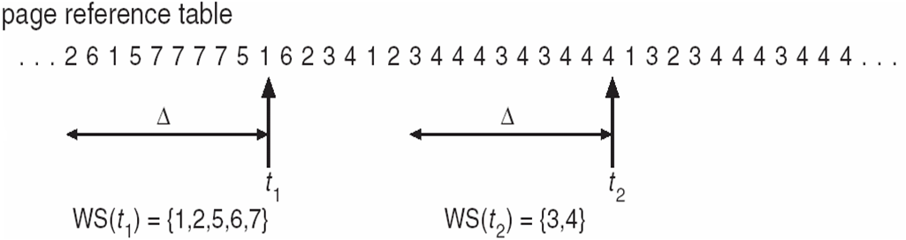
Working-Set Model
Δ ≡ working-set window ≡ a fixed number of page references WSS_{i} (working set of Process P_{i}) = total number of pages referenced in the most recent Δ (varies in time)
if Δ too small will not encompass the entire locality
if Δ too large will encompass several localities
if Δ = ∞ ⇒ will encompass entire program
Example

Slide 51
Cont..
D = Σ WSS_{i} ≡ total demand frames
Approximation of locality
m = total number of frames
If D > m ⇒ Thrashing
Policy if D > m, then suspend or swap out one of the processes

Slide 52
Keeping Track of the Working Set
Approximate with interval timer + a reference bit

Slide 53
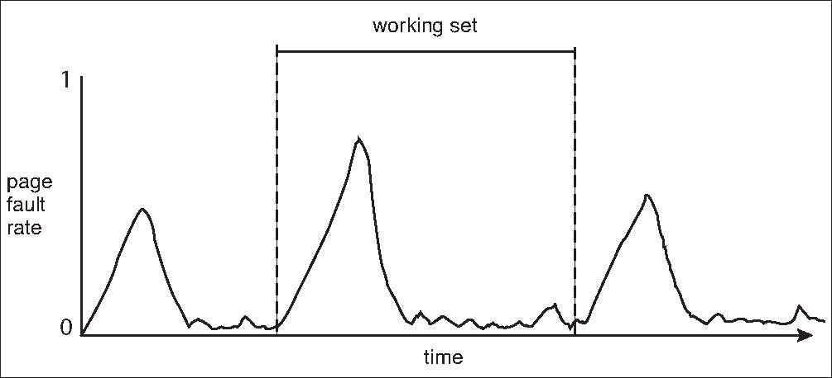
Working Sets and Page Fault Rates
Direct relationship between working set of a process and its page-fault rate
Working set changes over time
Peaks and valleys over time

Slide 54
Page-Fault Frequency
More direct approach than WSS
Establish “acceptable” page-fault frequency (PFF) rate and use local replacement policy
If actual rate too low, process loses frame
If actual rate too high, process gains frame

Slide 55
Examples
Consider a main memory with five page frames and the following sequence of page references: 3, 8, 2, 3, 9, 1, 6, 3, 8, 9, 3, 6, 2, 1, 3. Which one of the following is true with respect to page replacement policies First-In-First Out (FIFO) and Least Recently Used (LRU)?
(A) Both incur the same number of page faults (B) FIFO incurs 2 more page faults than LRU (C) LRU incurs 2 more page faults than FIFO (D) FIFO incurs 1 more page faults than LRU

Slide 56
Thank You

